Slide 1
Modern AI Pro: Building Agents

Slide 2
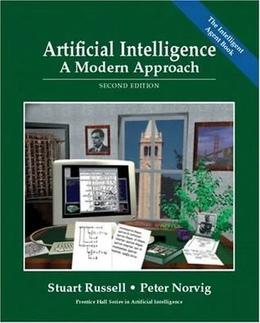
“Newest” Agentic AI book

Slide 3
Summary of this session
01
02
03
04
Add Memory
Add Tools
First Agent
ReAct framework

Slide 4


Agents vs. Automation.

Slide 5

Agents as a plumbing network.

Slide 6
Agents as pipes.
Job Pipelines | Workflows | Agents
Finance Pipeline: Market data → Analysis → Position sizing → Trade execution → Risk management | If RSI < 30 AND price below 200MA, then buy | Analyze market sentiment, correlate with global events, adapt to changing market regimes, and make nuanced position sizing decisions
Healthcare Pipeline: Patient symptoms → Test ordering → Results analysis → Treatment planning | If temperature >101°F AND cough present, order chest X-ray | Consider patient history, subtle symptom combinations, recent research, and unusual presentations to make more sophisticated diagnostic decisions
Content Moderation: Content ingestion → Analysis → Classification → Action | If text contains words from banned list, reject | Understand context, detect subtle hate speech, understand memes and cultural references, adapt to new types of harmful content

Slide 7
Agent types
Category | Core Function | Application
Creative/Generative Agents | Generate novel content or solutions | Augmenting human creativity and speeding up creative processes eg. Coding, writing etc.
Decision Pipeline Agents | Operate at decision nodes in established business processes | Replacing human decision-making in structured but complex processes. Eg. Risk management, healthcare
Collaborative/Orchestration Agents | Coordinate between multiple systems or stakeholders | Reducing coordination overhead and improving system integration. Eg. Meeting scheduling, Proj Mgmt

Slide 8
Agent types (contd)
Category | Core Function | Application
Environmental/Monitoring Agents | Continuous monitoring and adjustment | Providing constant vigilance and rapid response. Eg. Market sentiment analyzers, Network security monitors, Production line quality control, Infrastructure health monitors
Learning/Adaptive Agents | Improve performance through experience | Continuously improving performance based on new data. Sales strategy optimizers, Customer behavior predictors, Dynamic pricing engines, Fraud detection systems
Interface/Communication Agents | Bridge human-system interaction | Making complex systems accessible to humans Eg. Assistants and Chatbots

Slide 9
What is new about agents?
Agents:
Uses dynamic reasoning to determine actions
Can handle ambiguous situations
Learns and adapts through interaction
Combines multiple tools based on context
Example: Analyzing expense reports, asking clarifying questions, suggesting policy updates based on patterns
Process Automation:
Follows predefined, rigid rules and workflows
If-then logic with predictable paths
No dynamic reasoning or adaptation
Example: Automatically routing expense reports based on amount thresholds

Slide 10
Fixing LLM problems.

Slide 11
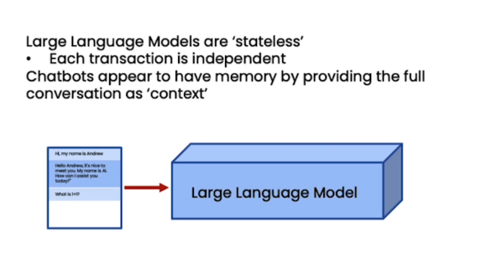
LLMs have no memory.

Slide 12
LLMs don’t have context: Add RAG
1. LLMs have a great understanding of the world, but they don’t have a perfect memory of the facts. This causes hallucinations among other problems.
2. The way to fix this problem is to allow it to open up a “book” when it needs so.

Slide 13
Benefits of Retriever Augmented generation
Add and remove data dynamically on demand
Keep data independent of models – allows for rapid switch of models and architectures.
Reduce hallucinations
Increase security and privacy with better access control

Slide 14
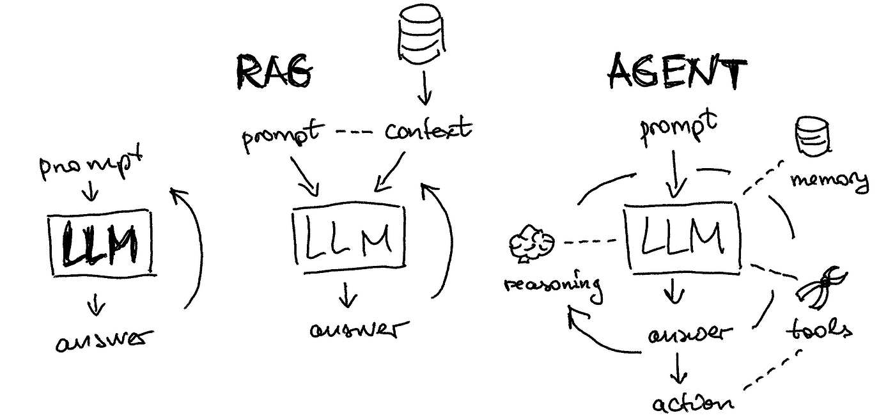
What is so cool about Agents?

Slide 15
What is so cool about Agents?
1. Low level goals to high level goals
2. One shot to an iterative process
3. Planning to break down tasks
4. Using tools to execute the tasks
5. Get external feedback along the way
6. Keep a memory of everything
7. Access to real time and external data
8. Sync to Async

Slide 16
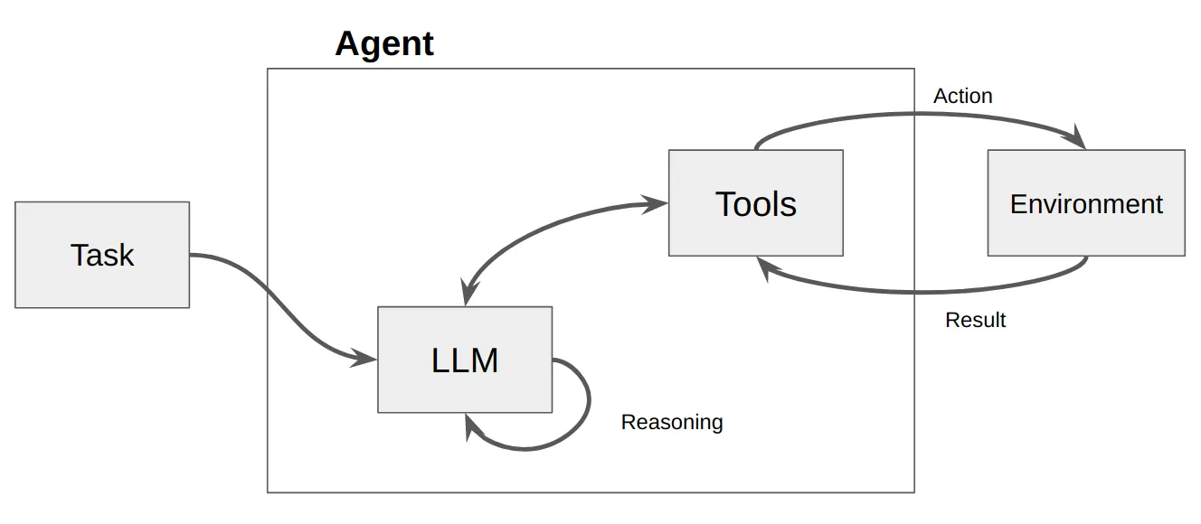
The ReAct Framework of Agents!

Slide 17
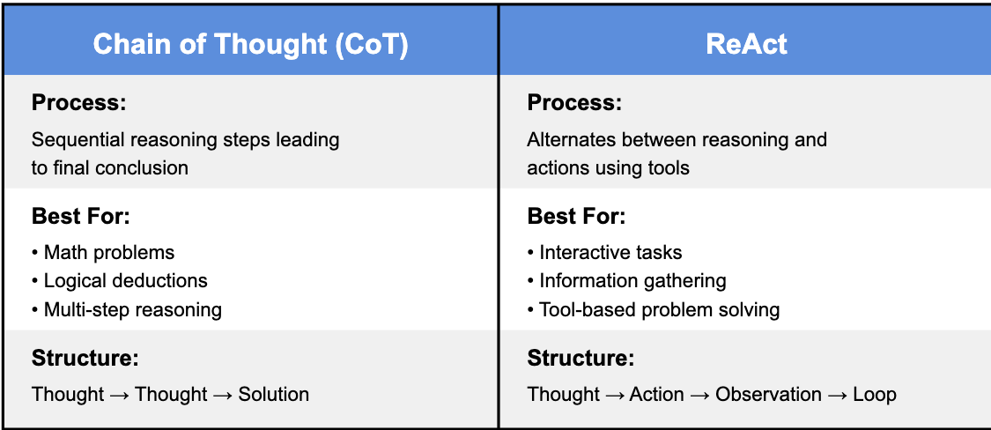
ReAct vs CoT

Slide 18
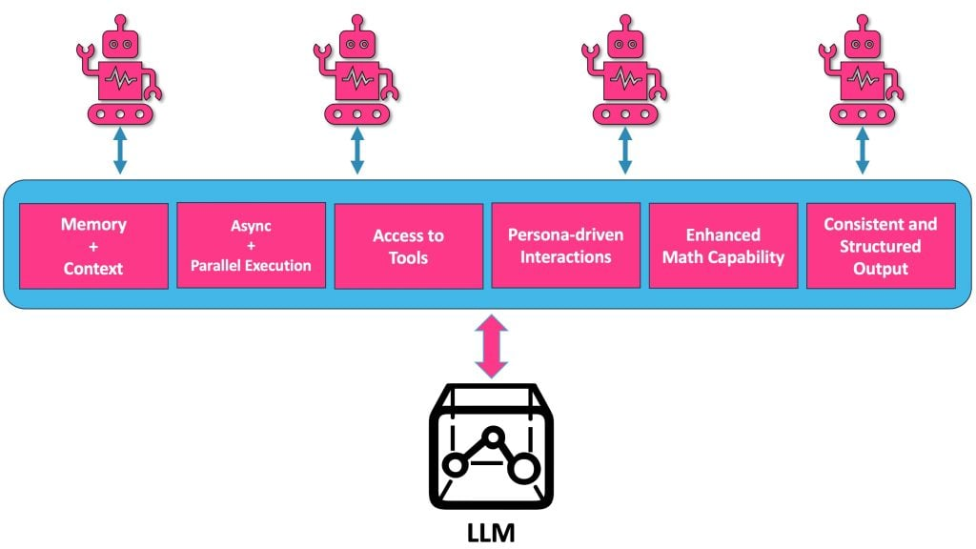
Towards Agents!

Slide 19
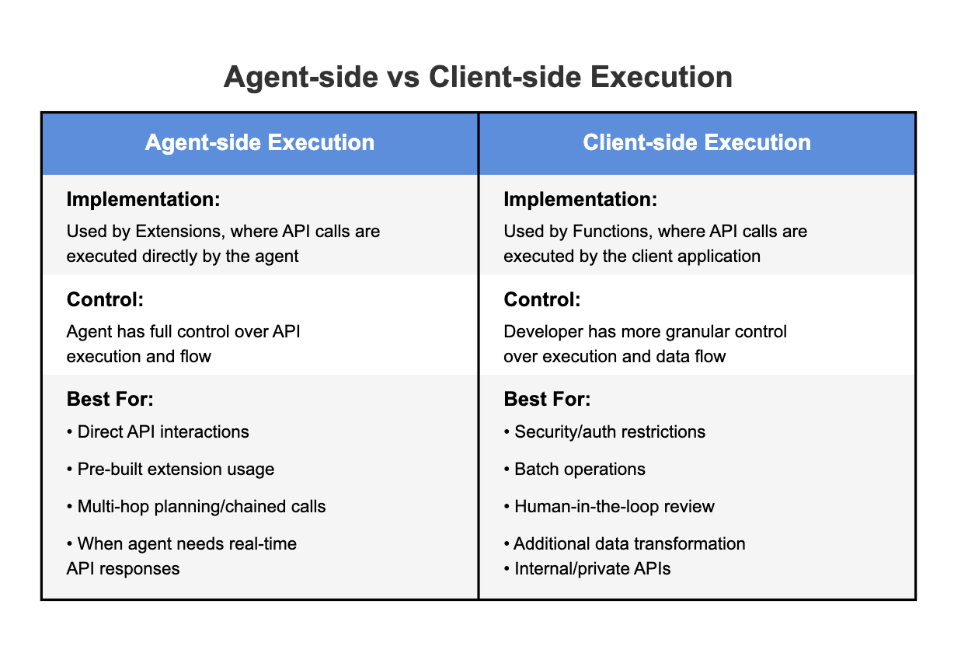
Extensions vs Functions.

Slide 20
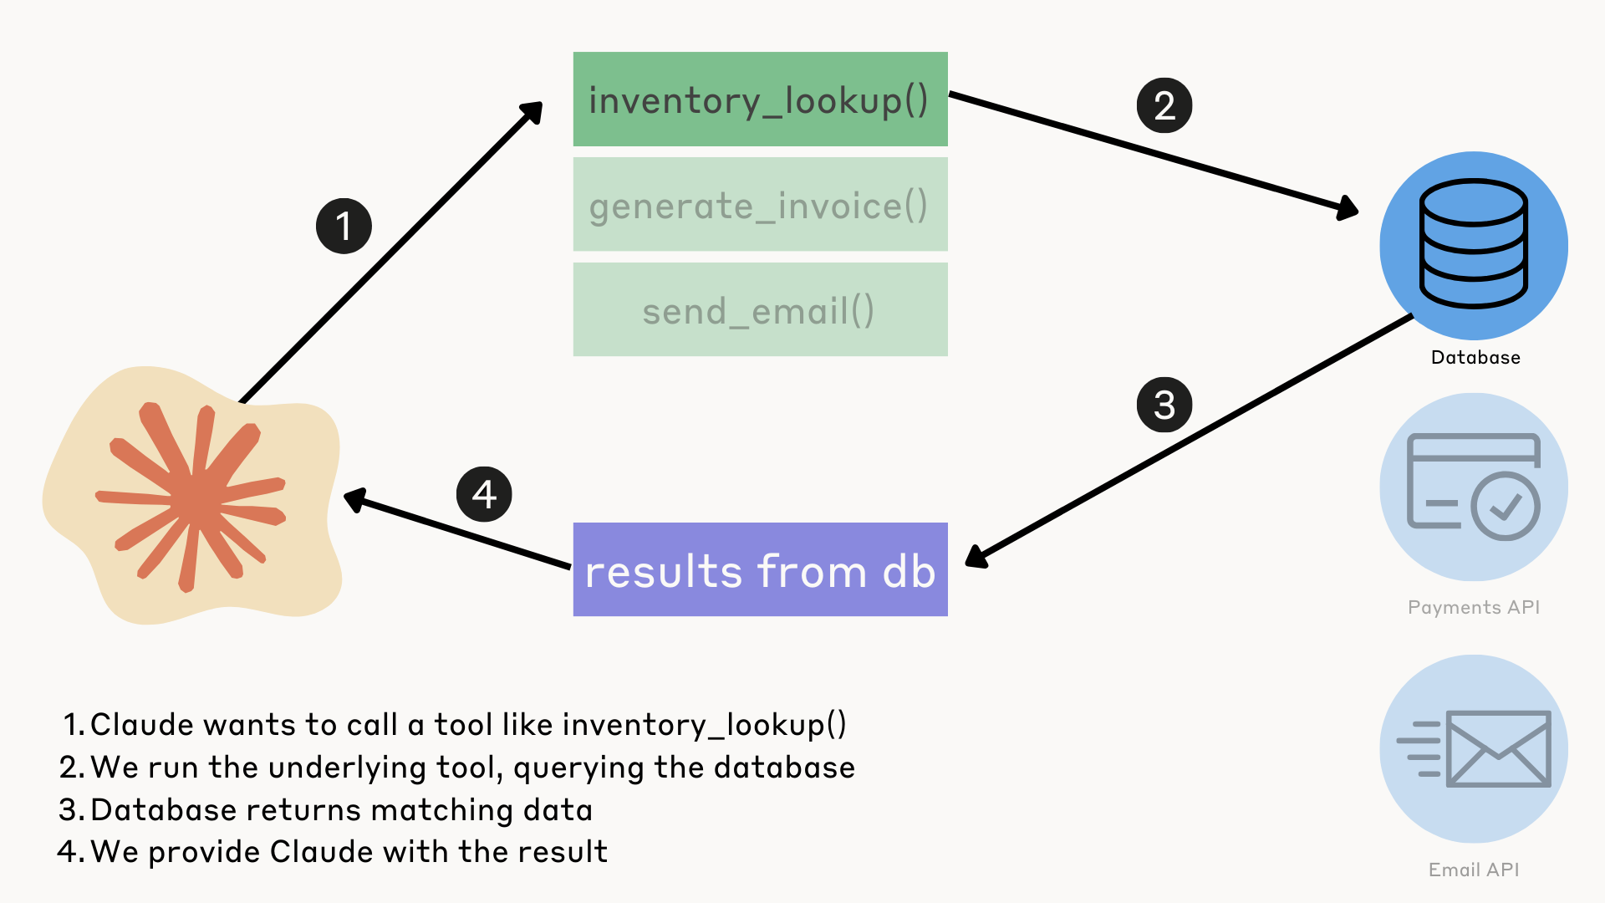
Towards Agents!

Slide 21
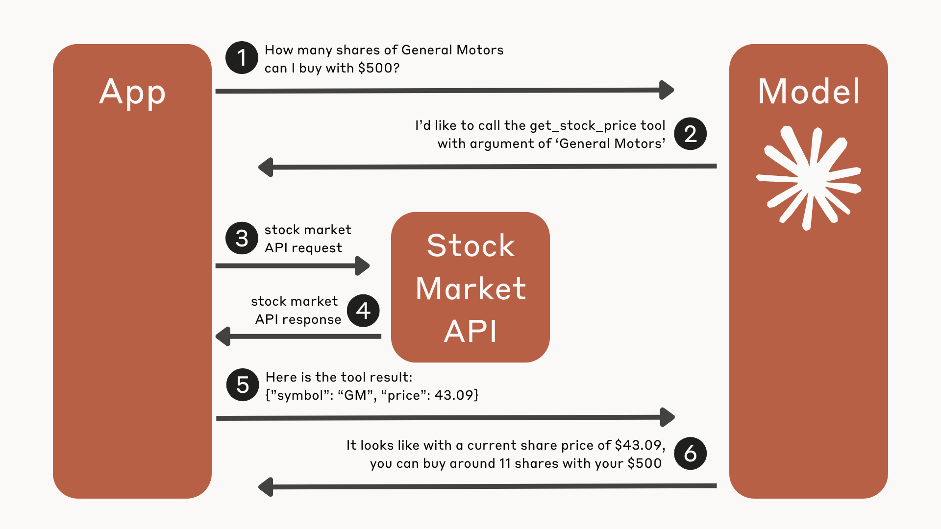

Slide 22
